Slide 1
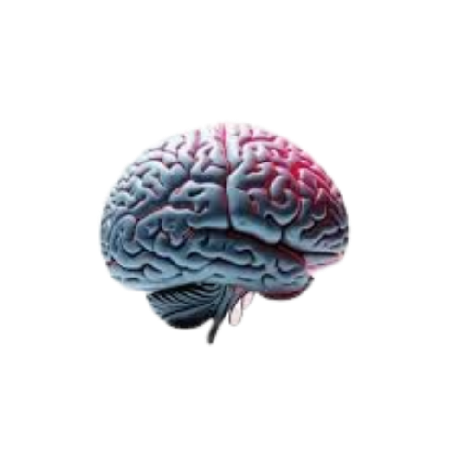
Neurox 3D Neurological Brain Segmentation
Team Members:
Sandireddy Manideep (22BCE1434)
Munta Sai Karthik (22BCE5060)
Gotam Sai Varshith (22BCE1605)
Guide Name:
Dr. Jayaram B
SCHOOL: SCOPE
Academic Year: 2022

Slide 2
Problem Statement
The core problem addressed by this project is the lack of a unified, high-efficiency system for simultaneously analyzing multiple neurological conditions from a single MRI scan. Current clinical workflows face several challenges:
Siloed Diagnostic Tools:
Existing AI models are typically designed for a single task (e.g., only tumor segmentation), requiring clinicians to run multiple separate systems for a comprehensive patient assessment.
Inconsistent Data & Quality:
Using separate models can lead to inconsistent data quality and negative transfer, making it difficult to achieve a unified view of a patient's neurological health.
Clinical Uncertainty:
Many existing AI assistants provide "black-box" predictions without quantifying diagnostic uncertainty, which is critical for medical professionals making treatment decisions.
Complex Coexistence:
Critical conditions like brain tumors, strokes, and Alzheimer's disease can coexist, yet they are rarely analyzed together in a single, high-performance deep learning pipeline.

Slide 3
Motivation
The motivation for developing NeuroX stems from the need to provide a "clinically-viable AI diagnostic assistant" that can streamline complex neurological evaluations:
Unified Multi-Disease Diagnostics:
The project was driven by the need to replace siloed tools with a single system capable of detecting Brain Tumors, Stroke, and Alzheimer's from one MRI scan, significantly reducing clinical analysis time.
High-Fidelity Precision and Visualization:
A primary motivation was to assist medical professionals in accurately locating and quantifying pathologies through the generation of precise 3D brain visualizations and high-resolution 2D clinical heatmaps.
Clinical Trust via Uncertainty Quantification:
To bridge the gap between AI predictions and clinical decision-making, the system incorporates Monte Carlo Dropout and heteroscedastic uncertainty to flag complex cases for immediate expert review.
Scientific Rigor and Automated Reporting:
The system ensures real-world utility by meeting publication-grade statistical standards through Nested Cross-Validation and simplifies physician workflows with an automated, AI-driven clinical reporting engine.

Slide 4
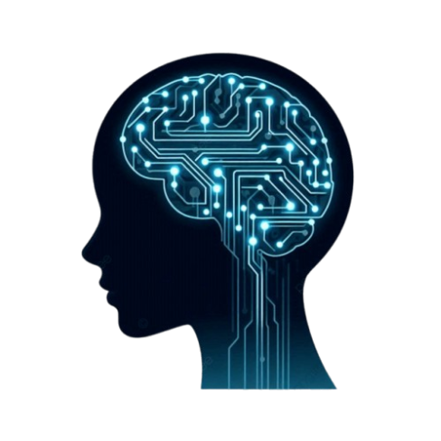
Objectives
Develop a unified AI-based system for analysing brain MRI scans.
Detect multiple neurological disorders including brain tumor, stroke, and Alzheimer’s disease.
Apply MRI preprocessing techniques such as normalization and skull stripping for standardized input.
Extract deep volumetric features using 3D CNN and transformer-based architecture.
Perform accurate lesion segmentation for abnormal brain region localization.
Generate confidence-aware predictions and automated diagnostic reports.

Slide 5
Literature Review
Paper / Method | Techniques Used | Key Findings | Limitation
Attention U-Net | U-Net with attention gates for medical image segmentation | Improved lesion localization and segmentation accuracy | Focused only on segmentation, no classification support
Transformer-Based MRI Diagnosis | CNN + Transformer self-attention mechanism | Captures global spatial relationships effectively | High computational complexity
3D CNN for Brain MRI Classification | Volumetric 3D convolution layers | Strong feature extraction from MRI volumes | Limited interpretability and no reporting system
Automated Brain Tumor Segmentation Models | CNN-based segmentation methods | Accurate tumor boundary detection | Works only for tumor-specific diagnosis

Slide 6
Literature Review
Paper / Method | Techniques Used | Key Findings | Limitation
Deep Learning-Based Stroke Lesion Segmentation | CNN-based lesion segmentation | Improved stroke lesion detection in MRI | Sensitive to dataset imbalance
MRI-Based Alzheimer Detection Models | Deep CNN classification | Detects structural degeneration patterns | Limited generalization across datasets
Hybrid CNN-Transformer Medical Models | CNN + Transformer hybrid architecture | Better local and global feature learning | Computationally intensive
Our Proposed System (NeuroX) | 3D CNN + Transformer + Attention Decoder | Unified multi-disease MRI diagnosis | Requires larger clinical validation

Slide 7
Research Gap
Limitations in Existing Systems
Most existing systems focus on single neurological disease detection only.
Classification and segmentation are usually developed as separate modules.
Existing models often lack confidence estimation for prediction reliability.
Automated clinical report generation is rarely integrated.
Many systems are difficult to generalize across MRI datasets from different sources.
Technical Gap
Limited use of unified architectures combining 3D CNN and transformer learning.
Lack of practical frameworks supporting tumor, stroke, and Alzheimer detection together.
Gap Addressed by NeuroX
NeuroX proposes a unified pipeline integrating multi-disease detection, segmentation, confidence estimation, visualization, and report generation.

Slide 8
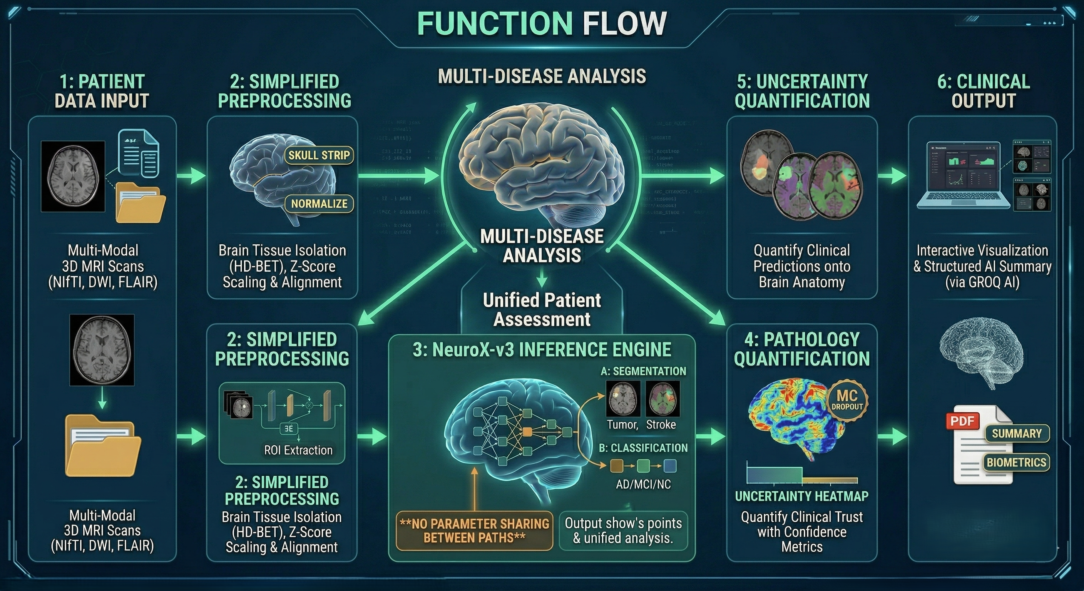
Proposed System
Overview of the Solution
NeuroX is a unified AI-based medical imaging framework designed to analyze brain MRI scans for detecting multiple neurological disorders within a single diagnostic pipeline.
The proposed system performs:
Brain tumor detection
Stroke lesion detection
Alzheimer pattern identification
Lesion segmentation
Confidence-aware prediction
Automated report generation

Slide 9
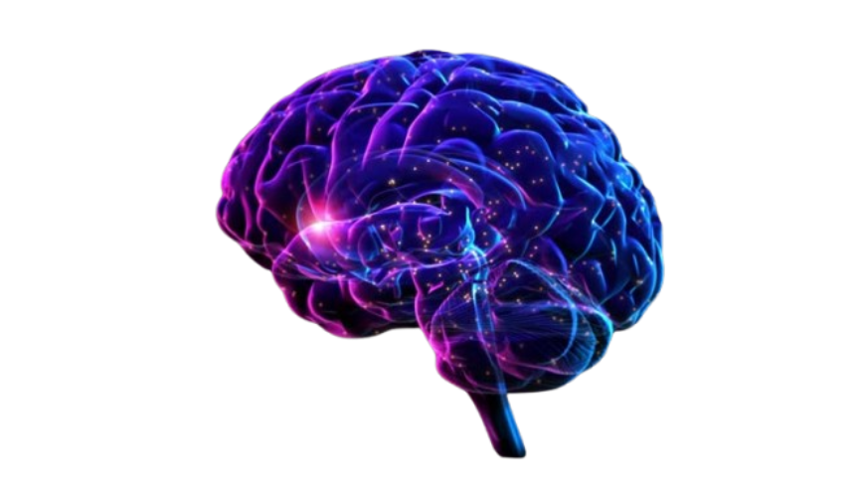
Proposed System
Innovation and Engineering Contribution
Innovation / Novelty
Unified diagnosis for tumor, stroke, and Alzheimer’s disease
Hybrid 3D CNN + Transformer architecture
Attention-guided decoder for segmentation
Confidence estimation using uncertainty analysis
Engineering Contribution
Modular medical inference pipeline
Automated PDF reporting system
Streamlit-based clinical interface
Integrated 3D lesion visualization
Core Contribution
NeuroX combines multiple medical AI tasks into one deployable framework.

Slide 10
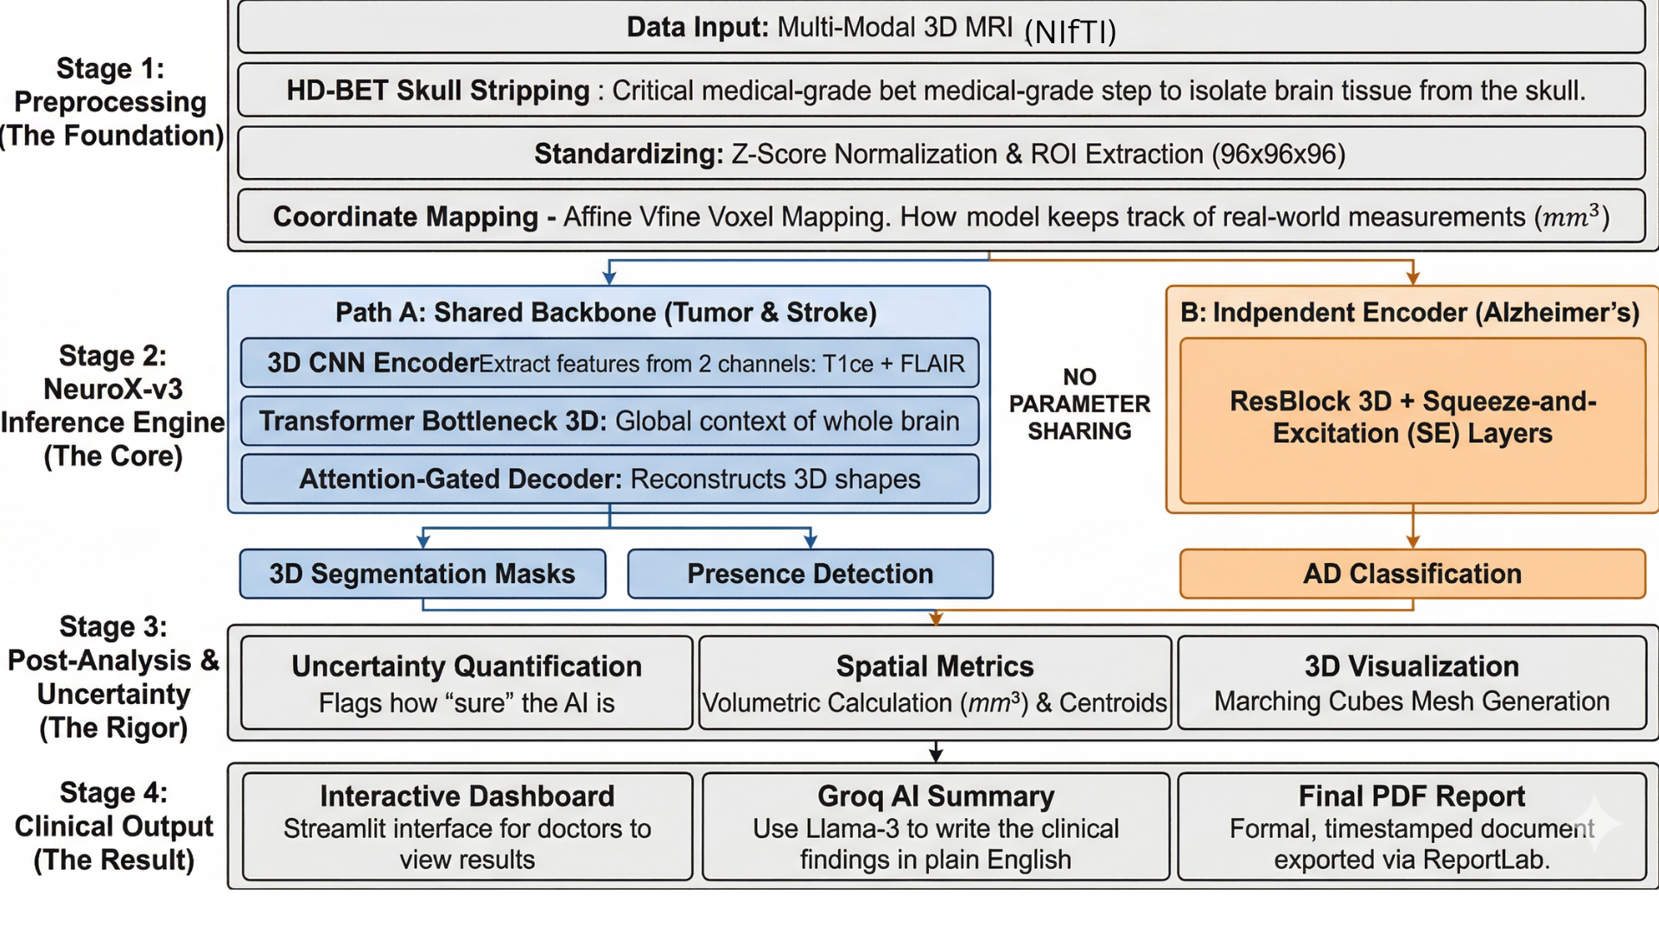
System Architecture
Block Diagram

Slide 11
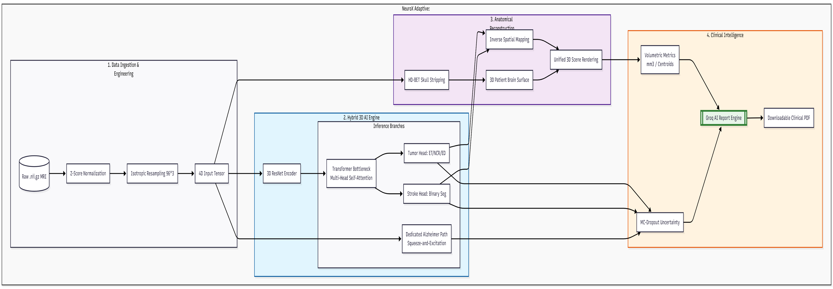
System Architecture
architecture DIAGRAM

Slide 12
System Architecture
Data Flow Diagram

Slide 13
Methodology
Algorithm
1. Preprocessing & Input Routing
The algorithm begins by standardizing the input MRI to ensure consistency across different scanners:
Normalization: Voxel intensities are normalized using Z-score techniques and clipped to remove outliers.
Spatial Alignment: The 3D volume is resampled to a uniform 96×96×96 Region of Interest (ROI).
Channel Packing: For tumor and stroke tasks, the system uses a dual-channel input (typically T1ce and FLAIR sequences) to provide the model with better contrast for focal lesions.

Slide 14
Methodology
Algorithm
2. The Core Architecture (NeuroX-v3)
The system utilizes an asymmetric dual-path engine to process different types of brain pathologies:
Path A: Shared Clinical Backbone (Tumor & Stroke)
Encoder: A 3D Convolutional Neural Network (CNN) with Instance Normalization extracts spatial features.
Transformer Bottleneck: A Latent Transformer models global spatial dependencies, helping the model understand the anatomical context of detected lesions.
Segmentation Decoders: An Attention-Gated U-Net structure is used to generate the 3D masks. Attention gates suppress irrelevant features, focusing the model on the precise boundaries of the tumor or stroke.
Path B: Independent Alzheimer’s Path
Dedicated Encoder: Alzheimer's detection uses a separate 3D Residual CNN (ResBlock3D) with Squeeze-and-Excitation (SE) blocks.
Global Analysis: Unlike the focal lesion path, this branch analyzes diffuse patterns of cortical atrophy to classify the presence of Alzheimer's.

Slide 15
Methodology
Algorithm
3. Detection & Uncertainty Algorithm
For all three conditions, the algorithm employs a probabilistic approach:
Presence Heads: Fully connected layers output a probability score for each disease.
Uncertainty Quantification: The system uses Monte Carlo (MC) Dropout and a dedicated Log-Variance head to calculate epistemic and aleatoric uncertainty. This provides a confidence level for every detection, identifying cases that may require closer expert review.

Slide 16
Methodology
Algorithm
4. 3D Mesh Generation & Clinical Mapping
To produce the final 3D output, the algorithm executes several geometric steps:
Marching Cubes Algorithm: This is applied to the tumor and stroke segmentation masks to create a 3D surface mesh.
Inverse Affine Transformation: The results are mapped back from the 96³ ROI to the original patient space using the MRI's NIfTI Affine Matrix. This ensures that calculated metrics, such as lesion volume (mm³) and centroid coordinates (World RAS), are anatomically accurate for the clinical report.
5. Training Curriculum
The model was optimized using a 48-epoch Phase-Aware Curriculum:
Phase 1: Focuses on warming up the Alzheimer's path.
Phase 2: Initializes the segmentation decoders for tumor and stroke.
Phase 3: Joint training where all paths are optimized together to reach a final calibrated state.

Slide 17
Tools & Technologies Used
Core Development
Python 3.8+ – Main programming language
PyTorch 2.0+ – Deep learning framework
CUDA 11.8+ – GPU acceleration
python-dotenv – Secure environment configuration
Medical Imaging & Processing
NiBabel – NIfTI MRI file handling
HD-BET – Brain extraction
Scikit-image – Image processing & 3D reconstruction
SciPy – Morphological operations
AI / Deep Learning Models
3D CNN Encoder – Feature extraction
Transformer Bottleneck 3D – Global context learning
Attention-Gated U-Net – Tumor & stroke segmentation
ResBlock3D + SE Layers – Alzheimer MRI classification
Visualization & Deployment
Streamlit – Clinical web interface
Plotly – Interactive 3D visualization
Matplotlib – Slice heatmaps
Trimesh – STL mesh export
Evaluation & Reporting
Scikit-learn – Metrics & validation
NumPy / Pandas – Data handling
ReportLab – PDF report generation
Groq AI (Llama-3) – AI-assisted neuroradiology reporting

Slide 18
Implementation Details
Modules Developed
Preprocessing Module: MRI loading, normalization, padding, resampling (96×96×96)
Detection Module: Shared 3D CNN + transformer bottleneck for tumor/stroke detection
Alzheimer Module: Independent residual encoder with uncertainty head
Segmentation Module: Attention U-Net for tumor and stroke lesion masks
Visualization Module: 3D lesion rendering + brain extraction using HD-BET
Frontend Module: Interactive deployment using Streamlit

Slide 19
Implementation Details
Dataset Used
Tumor: BraTS Challenge 2020 + 2021 (1619 scans)
Stroke: ISLES Challenge 2022 (250 scans)
Alzheimer: Alzheimer's Disease Neuroimaging Initiative (1208 scans)
Experimental Setup
Framework: PyTorch
Hardware: Tesla T4 GPU
Training: 48 epochs, 3-phase curriculum learning
Batch Size: 1 with gradient accumulation (4)
Loss: Dice + BCEWithLogitsLoss
Calibration: Temperature Scaling + Monte Carlo Dropout

Slide 20
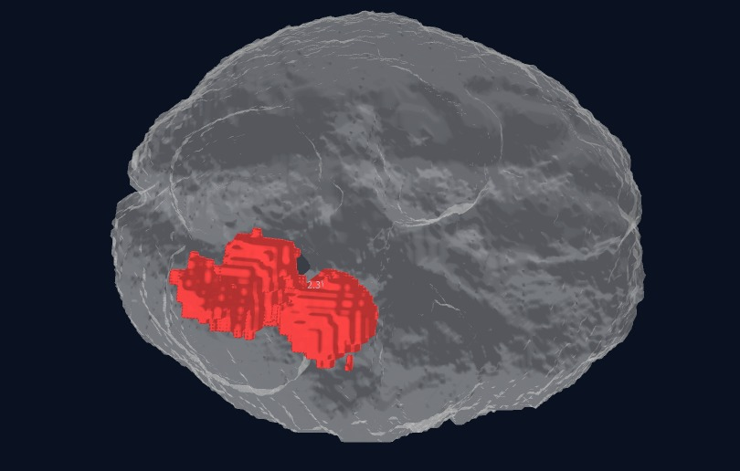
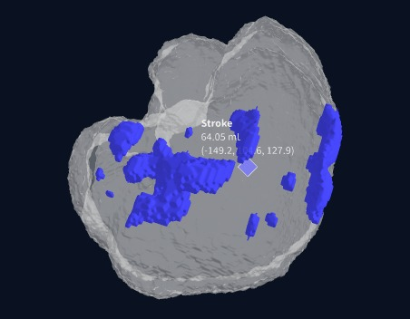
results and analysis

Slide 21
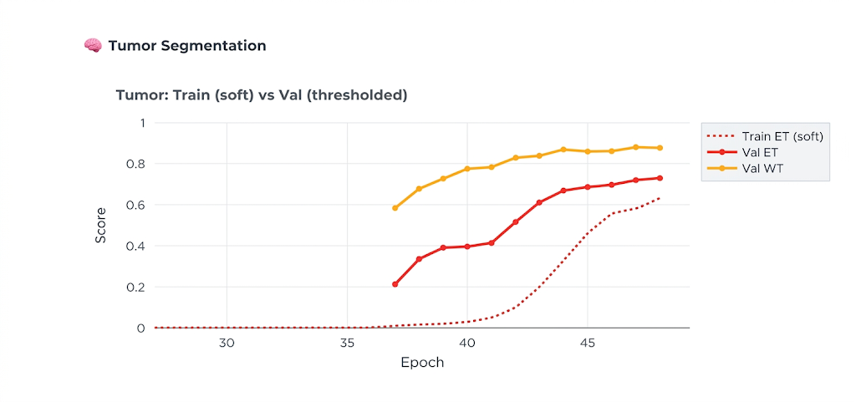
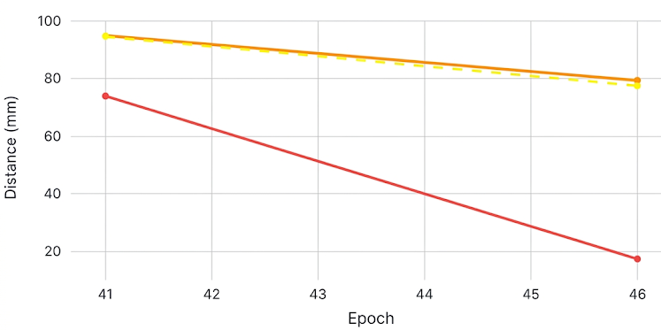

results and analysis
Tumor segmentation
Train (soft) vs Val (threshold)
Tumor Val HD95 & ASD (mm) – only HD epochs

Slide 22
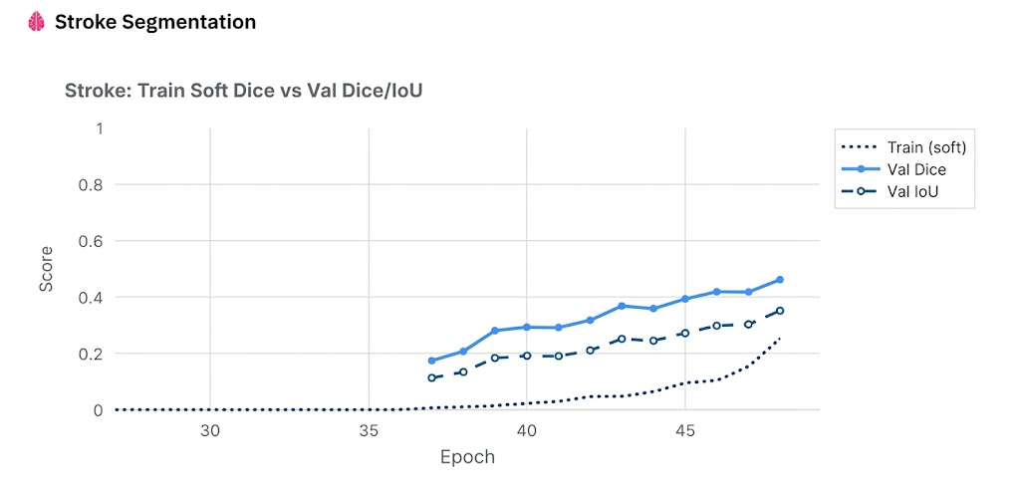
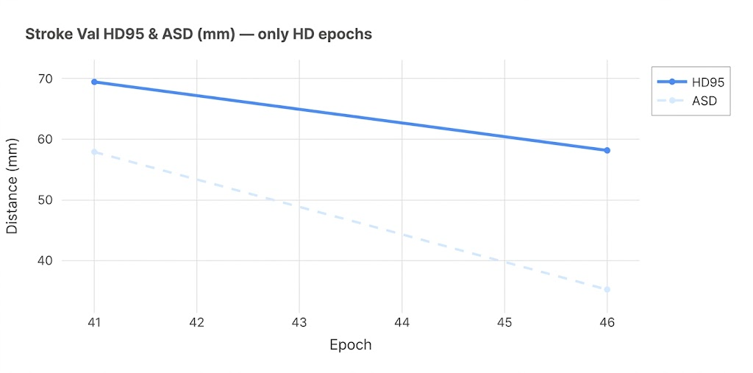
results and analysis
STROKE segmentation
Train Soft Dice vs Val Dice/IOU
Stroke Val HD95 & ASD (mm) – only HD epochs

Slide 23
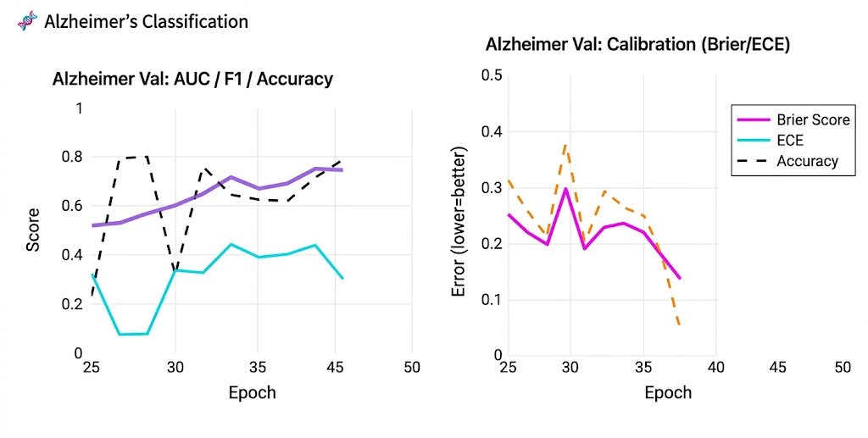
results and analysis
Alzheimer segmentation
Alzheimer Val: AUC / F1 / Accuracy
Alzheimer Val: Calibration (Brier/EUE)

Slide 24
results and analysis
Performance Metrics
Metric | Best Value | Best Epoch | Phase
Tumor ET Dice (val) | 0.7637 | Ep 26 → held constant | Phase 2 SEG (ep 26)
Tumor TC Dice (val) | 0.8322 | Ep 26 → held constant | Phase 2 SEG (ep 26)
Tumor WT Dice (val) | 0.8902 | Ep 26 → held constant | Phase 2 SEG (ep 26)
Stroke Dice (val) | 0.5005 | Ep 27 onward (plateau) | Phase 3 Joint (ep 27+)
Stroke IoU (val) | 0.4051 | Ep 27 onward (plateau) | Phase 3 Joint (ep 27+)
Alzheimer Loss (train) | 0.2052 | Ep 48 | Phase 3 Joint (final)
Global Score (best) | 2.0385 | Ep 34 | Phase 3 Joint
Stroke Train Dice | 0.6412 | Ep 26 (warmup peak) | Phase 2 SEG

Slide 25
Comparison: Existing vs Proposed System
Parameter | Existing Systems | Proposed NeuroX System
Disease Coverage | Detects only one disease at a time | Simultaneous detection of tumor, stroke, and Alzheimer’s
Model Architecture | Conventional CNN-based single-task models | Shared 3D CNN + transformer + dedicated Alzheimer branch
Segmentation Capability | Limited or disease-specific segmentation | Tumor multi-class + stroke binary segmentation
Uncertainty Estimation | Not available in most systems | Monte Carlo dropout + variance prediction
Visualization | Mostly 2D outputs | Interactive 3D lesion visualization
Brain Extraction | Often manual or basic preprocessing | Automated using HD-BET
Clinical Reporting | Manual interpretation required | Automated PDF clinical report generation
Deployment | Research-only standalone scripts | Interactive deployment using Streamlit
Dataset Handling | Separate models for separate datasets | Unified multi-dataset training framework

Slide 26
Applications of NeuroX
Industry Relevance
Useful in hospitals and diagnostic centers for assisting MRI-based neurological screening
Supports radiologists in early detection of tumor, stroke, and Alzheimer’s disease
Can reduce manual workload in multi-scan clinical analysis
Applicable in medical AI research and decision-support systems
Suitable for integration with hospital imaging workflows
Real-Time Deployment
Deployed as interactive web application using Streamlit
Accepts MRI scans in NIfTI format for direct analysis
Generates disease prediction, segmentation, and 3D visualization in one workflow
Produces automated PDF clinical reports for rapid review
Can run on GPU-enabled systems for faster inference

Slide 27
Challenges Faced During NeuroX Development
Major Challenges
Handling different MRI modalities across tumor, stroke, and Alzheimer datasets.
Managing large 3D MRI volumes, which increased memory usage during training.
Severe class imbalance, especially in stroke and Alzheimer datasets.
Integrating three different disease tasks into a single unified architecture.
Achieving stable segmentation performance for small lesions.
Stroke performance plateau due to limited ISLES Challenge dataset size.
Ensuring compatibility of model checkpoints across architecture updates.
High training time on Tesla T4 GPU due to 3D computation.

Slide 28
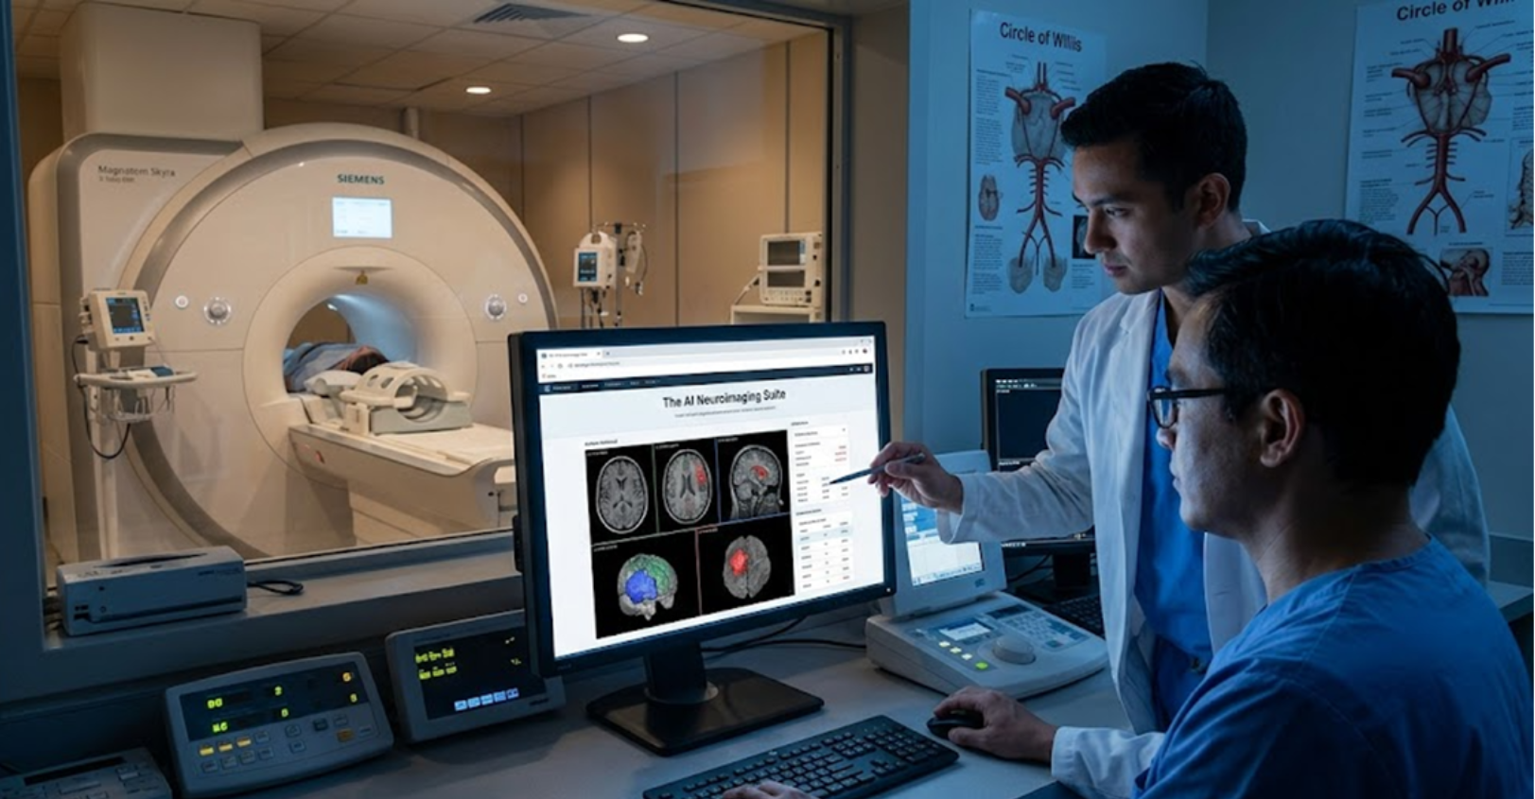
Conclusion
NeuroX successfully integrates tumor, stroke, and Alzheimer’s detection into a single MRI analysis framework
The proposed system combines 3D CNN, transformer bottleneck, and task-specific decoders for multi-disease prediction
Accurate lesion segmentation was achieved for tumor and stroke cases
Uncertainty estimation improved prediction reliability for clinical interpretation
3D visualization and automated reporting enhance practical usability
The system demonstrates strong potential as an AI-assisted neuroimaging tool

Slide 29

Future Work
Integrate additional neurological disorders such as haemorrhage and multiple sclerosis
Expand stroke training using larger datasets beyond ISLES Challenge
Improve real-time inference speed for clinical deployment
Add multi-sequence MRI fusion (T1 + T2 + FLAIR)Validate on external hospital datasets
Explore PACS integration for hospital workflow deployment

Slide 30


